Slide 1
SCM 651: Business Analytics
Week 3

Slide 2
Agenda
Google Analytics Access
Required for Homework #2
Homework #1
due before class in Week 4 live session (next week)
Review of concepts
Group discussion of articles
Web Analytics: Enhancing Customer Relationship Management
How eBay Uses Data and Analytics to Get Closer to Its (Massive) Customer Base

Slide 3
Week 3 - Review
Google Analytics purpose
Allows a website owner to track and analyze traffic
When someone visits a website, their IP address, location, and computer settings are transmitted to the website

Slide 4
Week 3 - Review
Google Analytics: general measures
Sessions: number of times the site was visited (does not count pages)
Users: number of unique users identified by IP addresses
Pageviews: number of individual web pages viewed
Pages/Session: average number of pages viewed in a session
Avg. Session Duration: time spent on website before leaving
Bounce Rate: percentage of visitors who do not visit a second page
% New Sessions: percentage of sessions with new users

Slide 5
Week 3 - Review
Google Analytics: audience
Languages
Locations: Countries, states, cities
System: Browser, operating system
Mobile: operating system, screen resolution
Demographics: Age, Gender
Interests: affinity categories, markets
Geographic: languages, countries, continents, cities (note some redundant information from before)

Slide 6
Week 3 - Review
Google analytics: audience
New vs. returning
Frequency and recency
Engagement (length of time on site)

Slide 7
Week 3 - Review
Google Analytics: audience
Benchmarking: comparing your website to industry average
User flow: path analysis, entry and exit points

Slide 8
Week 3 - Review
Google Analytics: Acquisition
Channels (organic search, direct, referral, social, email)
Source/medium (google/organic, direct/none, syr.edu/referral, bing/organic, va.gov/referral)

Slide 9
Week 3 - Review
Google Analytics: Google Ads
Advertising (key words, adwords)
Dayparting (time of day)
Google Analytics: social
Facebook, LinkedIn, Twitter, Google+
Google Analytics: all campaigns
Can track traffic from non-Google Ad campaigns

Slide 10
Week 3 - Review
Google Analytics: Behavior
Site content (ability to drill down to each web page for page views, average time on page, bounce rate, exit %)
Landing pages (first page viewed by user)
Exit pages (last page viewed by user)
Site speed, page timings, speed suggestions

Slide 11
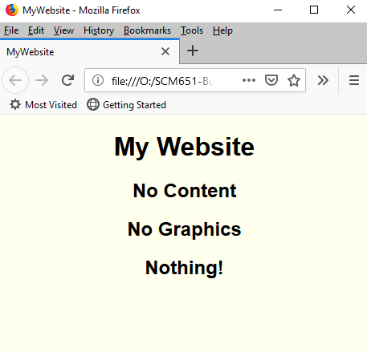
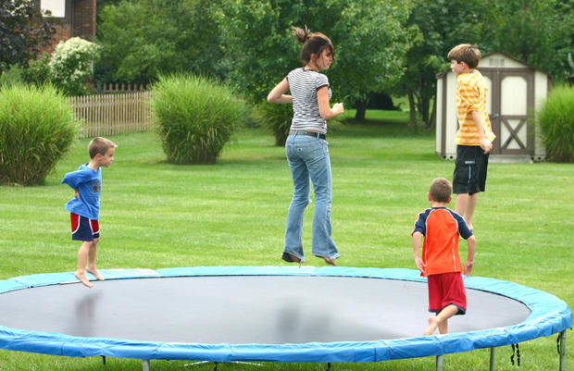
What do a trampoline and a bad website have in common?
A high bounce rate!
Trampoline
Bad Website

Slide 12
Google Analytics - Video
Video: Hal Varian, Google Trends
https://www.youtube.com/watch?v=poas_GXSou8#t=142

Slide 13
Article #1: Web Analytics
Web Analytics: Enhancing Customer Relationship Management
Describe the four main categories of metrics and relate to the Google analytics lessons
Website usability; Traffic sources; Visitor profiles; Conversion statistics
Describe the common techniques for Web analytics
Clustering/classification; Association rules; Path analysis; Sequential patterns
What are some business applications of web analytics?

Slide 14
Article #2: How eBay Uses Data
How eBay Uses Data and Analytics to Get Closer to Its (Massive) Customer Base
What is an A/B test and what is its purpose?
Describe the three biggest challenges of web data
Data at a large scale
Collecting the right data
New kinds of data
How can Power Sellers use data better?
Why are web analytics better than surveys?

